Slide 1

Lakbay

Slide 2
Transform the way we experience the Philippines

Slide 3

Economy

Slide 4
Economy
Cultural Awareness

Slide 5

70% of Filipinos will have mobile phones by 2018.
As mentioned by an article from business.inquirer.

Slide 6

Tourism has been increasing in various places, with Sagada doubling its tourists in 2015 alone
As mentioned by an article from rappler.

Slide 7

Application Demo

Slide 8

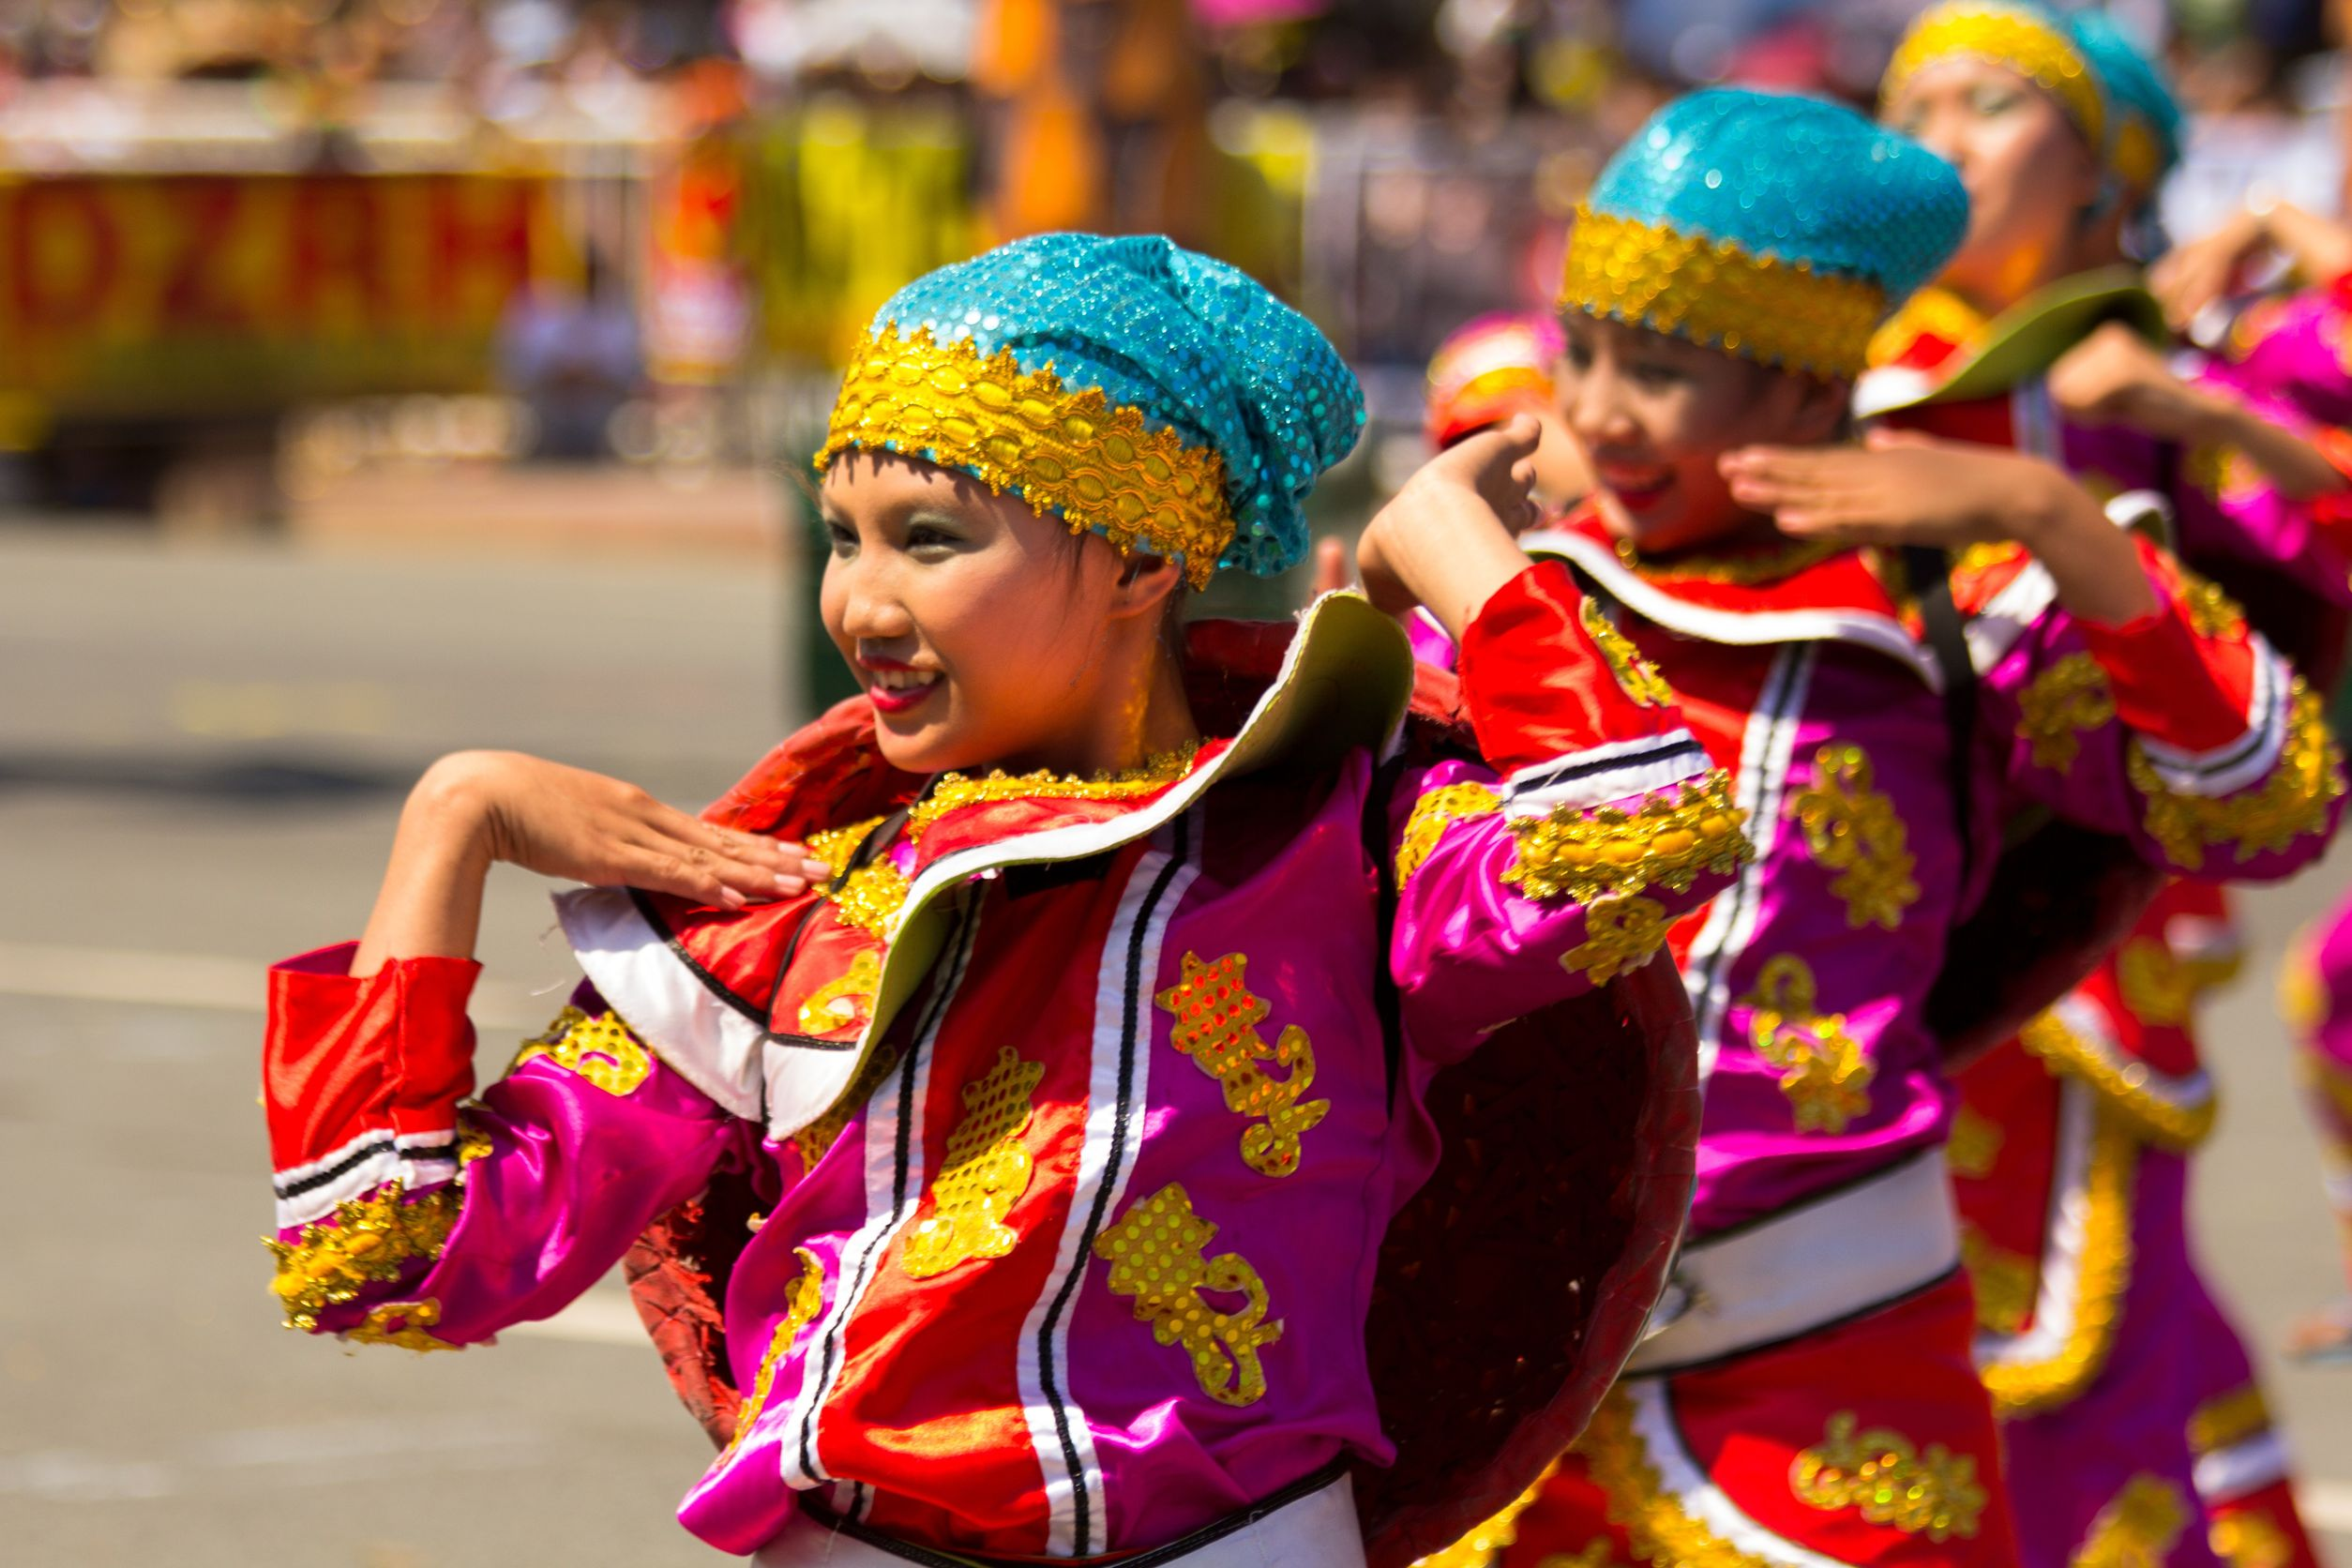
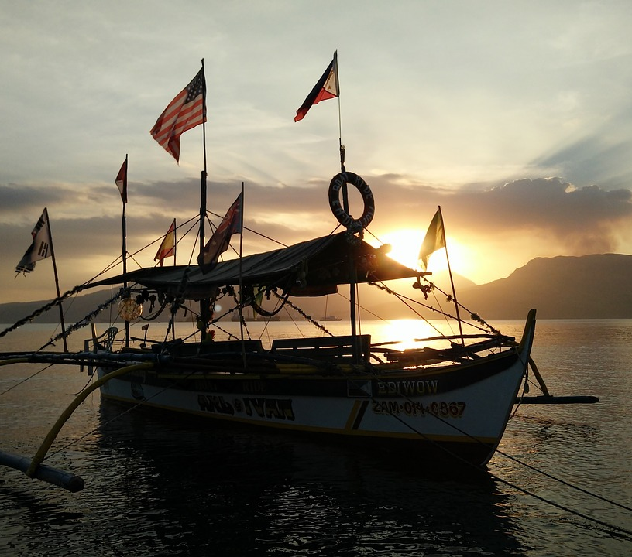
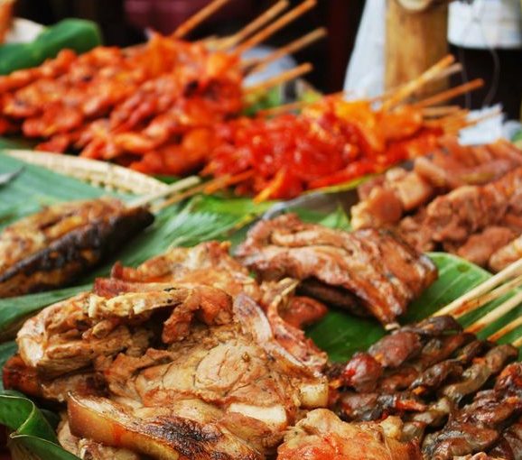
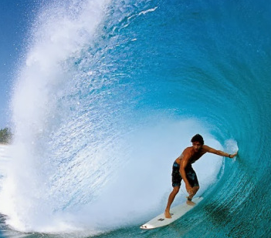
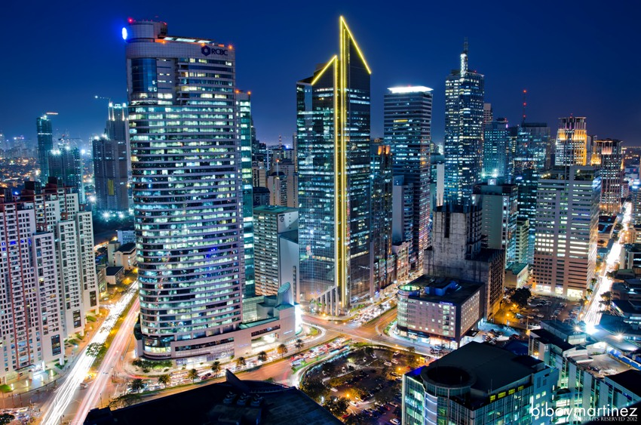
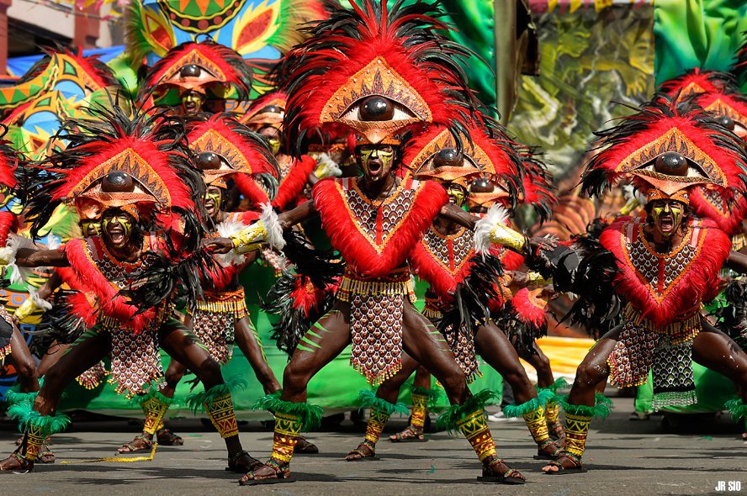

Slide 9

Tara na! Lakbay!

